Slide 1

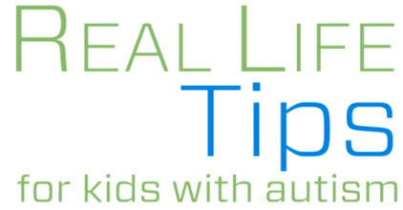
Write the Title Here
www.childrens-specialized.org/KohlsAutismAwareness

Slide 2
Enter text here…
1

Slide 3
Enter text here…
2

Slide 4
Enter text here…
3

Slide 5
Enter text here…
4

Slide 6
Enter text here…
5

Slide 7
Enter text here…
6

Slide 8
Enter text here…
7

Slide 9
Enter text here…
8

Slide 10
Enter text here…
9

Slide 11
Enter text here…
10

Slide 12




www.childrens-specialized.org/KohlsAutismAwareness
For more information about this program contact: KohlsAutismAwareness@childrens-specialized.org
This autism education program is provided by Children’s Specialized Hospital through the generosity of Kohl’s Cares.
© 2014 Children’s Specialized Hospital

